Slide 1
Week 9
Emerging Technology & Career Development

Slide 2
Session Outline
Learning Objectives
What is Emerging Technology?
Biotechnology
Nanotechnology
ICT
Career Development in Corporate Sustainability
Summary
Vocabulary Review
Required Materials
Supplemental Materials
Assignment
References
Image Credits

Slide 3
Learning Objectives
By the end of this session, you will be able to:
Identify different types of emerging technology
Identify job possibilities in corporate sustainability
Recognize skillsets required for jobs in corporate sustainability

Slide 4
What is Emerging Technology?
Emerging technologies are characterized by radical novelty, relatively fast growth, coherence, prominent impact, and uncertainty and ambiguity.
Its most prominent impact, however, lies in the future and so in the emergence phase is still somewhat uncertain and ambiguous (Rotolo et al., 2015).

Slide 5
Biotechnology
Simply, biotechnology is technology based on biology - biotechnology harnesses cellular and biomolecular processes to develop technologies and products that help improve our lives and the health of our planet (bio.org, 2016)

Slide 6

Examples
Medicine
Genetic testing, molecular pharmaceutical drugs, etc.
Agriculture
Genetically modified crops
Industrial
Biofuels
Spider Silk
[dataphysics.com. [Image]. Retrieved from: http://www.dataphysics.de/fileadmin/user_upload/Applikationen/Biotechnology.jpg]

Slide 7
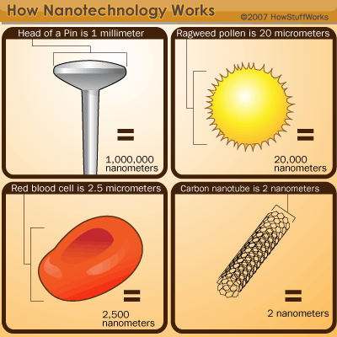
Nanotechnology
Nanotechnology is science, engineering, and technology conducted at the nanoscale, which is about 1 to 100 nanometers (molecular/atomic level) (Nano.gov, 2016).
[howstuffworks.com. [Image]. Retrieved from: http://s.hswstatic.com/gif/nanotechnology-4.gif]

Slide 8
Examples
Everyday products
Fabrics resistant to stain, wrinkling, bacteria growth
Eyeglasses that are water-repellent, self-cleaning, scratch resistant
Electronics
Magnetic random access memory (MRAM)
OLED screens, lighter and brighter picture
Sustainable Energy Applications
Nanostructured solar cells
Batteries less flammable, quicker-charging, lightweight
Medical
Disease and virus research
Early detection molecular imaging

Slide 9

ICT
ICT (information and communications technology) is an umbrella term that includes any communication device or application
[hop.com. [Image]. Retrieved from: http://hop.com.pk/wp-content/uploads/2014/11/ICT-job-creation-643x325.png]
Notes:
Image Source:

Slide 10
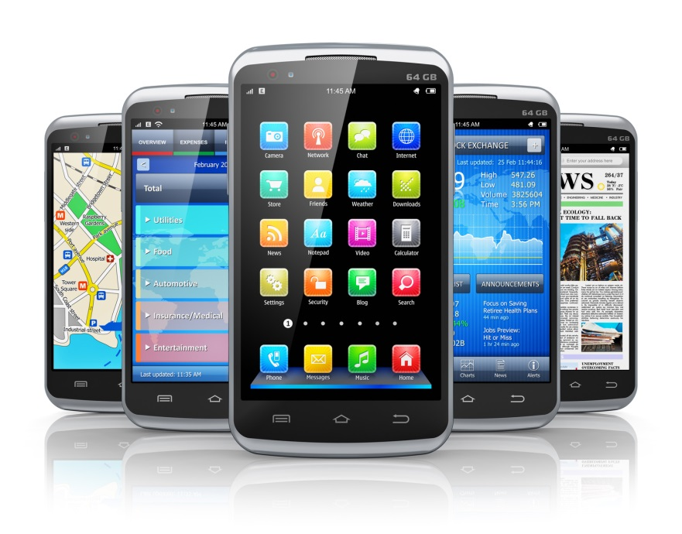
Examples
radio
television
cellular/smart phones
computer and network hardware and software
satellite systems
videoconferencing and distance learning
[top10smartphones.com. [Image]. Retrieved from: http://top10smartphone.com/wp-content/uploads/2014/09/top-10-smartphone-2.jpg]

Slide 11
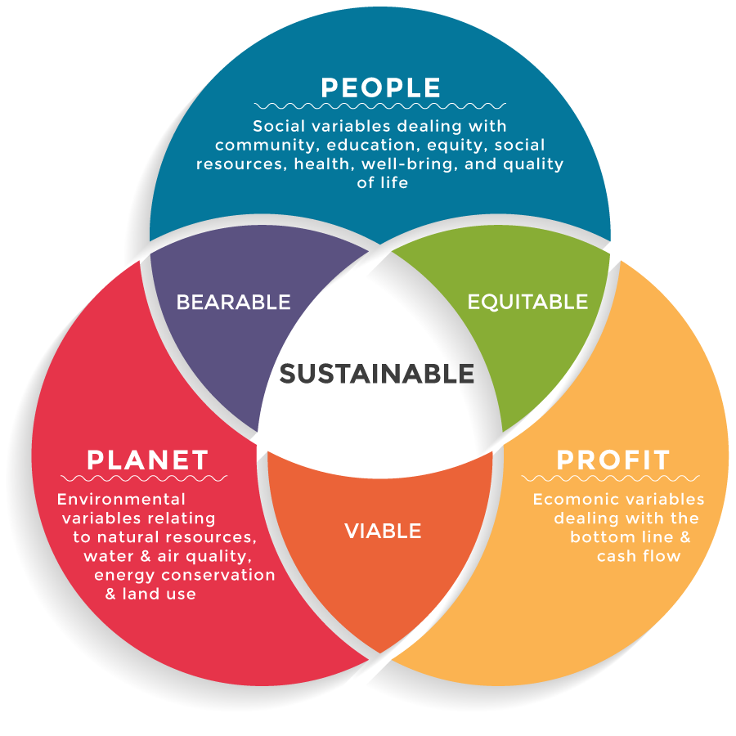
Emerging Technology & Business
Benefits of using Emerging Technology
Cost Reduction
Time Reduction
Output Quality
Quality of Work life (QWL)/Learning/Empowerment
3 Spheres of Sustainability or TBL
[CSR Ambassadors. [Image]. Retrieved from: http://www.csrambassadors.com/wp-content/uploads/2016/03/triple-bottom-line-1.png]

Slide 12
Job Possibilities in Corporate Sustainability
Corporate Sustainability/Corporate Social Responsibility (CSR)
Sustainability Consulting
Sustainable Supply Chain Management
Project & Program Management
Sustainable Real-estate & Green building
Energy & cleantech
Green Marketing/Communications/Reporting
Sustainable Investing & Financing

Slide 13
Example
Sustainable finance
relates to the ways in which the banking industry integrates environmental, social and governance issues into their business or investment decisions
Need the following skills:
strong analytical and writing skills and knowledge of environmental issues.
Background
International relations, economics, and finance

Slide 14
Job Opportunities
Public Sector
Private Sector
Notes:
Redo graph with just titles

Slide 15
Skillsets
Ability to motivate and inspire others
Ability to work in teams
Influential consensus building
Strong written and verbal communication
Networking and stakeholder engagement
Committed
Change management
Strategic thinking and planning
Project & program management
Systems thinking
Analytical
Reporting evaluation
Industry knowledge
Technical skills required by the position (e.g. marketing, financial modeling, supply chain management, etc.)

Slide 16
Resources for Sustainability Careers
B Corp Jobs Board
www.bcorporation.net/community/jobs-board
Boston College Center for Corporate Citizenship
www.bcccc.net
Bridgespan
www.bridgespan.org
BSR
https://www.bsr.org/en/careers/job-openings
Ethical Performance
www.ethicalperformance.com/recruitment
Green Dreams Jobs
www.sustainablebusiness.com/jobs
JustMeans
Jobs.justmeans.com
Net Impact
https://www.netimpact.org/careers2Degrees
Notes:
Technical skills mention it global application

Slide 17
Summary
Learning Objectives
Identify different types of emerging technology
Career Development
Job possibilities
Required skillsets

Slide 18
Vocabulary Review
Emerging Technology: Emerging technologies are characterized by radical novelty, relatively fast growth, coherence, prominent impact, and uncertainty and ambiguity.
Biotechnology: is technology based on biology - biotechnology harnesses cellular and biomolecular processes to develop technologies and products that help improve our lives and the health of our planet
Nanotechnology: is science, engineering, and technology conducted at the nanoscale, which is about 1 to 100 nanometers (molecular/atomic level)
ICT: (information and communications technology) is an umbrella term that includes any communication device or application
CSR: Corporate social responsibility referring to the business practices involving initiatives that benefit society.
TBL: Triple bottom line, often refereed as the 3 P’s (people, planet, profit) or the 3 E’s (equity, environment, economy)
3 Spheres of Sustainability: Social, Economical, and Environmental

Slide 19
Required Materials
Videos
Emerging Technology and Career Development, Michael Sieng. Available on the course website.
Programming Bacteria to Detect Cancer, Tal Danino, TED, Mar 2015.
Reading
Five Nanotechnology Research Projects that Could Deliver Big Results, Nanowerk News, 5 Aug 2016.

Slide 20
Supplemental Materials
Video
This Tiny Particle Could Roam your Body to Find Tumors, Sangeeta Bhatia, TED, Nov 2015.
Reading
‘Mind the gap’: science and ethics in nanotechnology, Anisa Mnyusiwalla et al., Nanotechnology, 13 Feb 2003.

Slide 21
Assignment
Think about different career opportunities available in the field of corporate sustainability, and decide upon one that you might be interested in pursuing. Develop and practice a 30-second career ‘pitch’ speech that you could use when looking for a job in the field. Imagine that you are using this speech at a career fair or networking event to make a strong first impression on a hiring manager. For inspiration, see Columbia University Center for Career Development’s 30-second Introduction. If you would like your pitch to be reviewed by course experts, please submit it to the Week 9 discussion board.

Slide 22
References
B Corporation. (2016). Retrieved August 09, 2016, from http://www.bcorporation.net/community/jobs-board
Berkeley Lab. (2016, August 03). 5 Nanoscience Research Projects That Could Deliver Big Results. Science Shorts. Retrieved August 8, 2016, from http://newscenter.lbl.gov/2016/08/03/nano-listicle/
Bhatia , S. (2015, November). Sangeeta Bhatia: This tiny particle could roam your body to find tumors [Video file]. Retrieved from http://www.ted.com/talks/sangeeta_bhatia_this_tiny_particle_could_roam_your_body_to_find_tumors
BIO. (2016). Retrieved August 09, 2016, from https://www.bio.org/
Boston College Center for Corporate Citizenship. (2016). Retrieved August 09, 2016, from http://ccc.bc.edu/index.cfm
Bridgespan. (2016). Retrieved August 09, 2016, from http://www.bridgespan.org/Home.aspx
BSR. (2016). Retrieved August 09, 2016, from http://www.bsr.org/
Danino, T. (2015, March). Tal Danino: Programming bacteria to detect cancer [Video file]. Retrieved from http://www.ted.com/talks/tal_danino_we_can_use_bacteria_to_detect_cancer_and_maybe_treat_it
Davenport, T. H., & Short, J. E. (1990). The new industrial engineering: information technology and business process redesign.
Ethical Performance. (2016). Retrieved August 09, 2016, from http://www.ethicalperformance.com/
Green Jobs. (2016). Retrieved August 09, 2016, from http://www.sustainablebusiness.com/jobs/
Justmeans. (2016). Retrieved August 09, 2016, from http://www.justmeans.com/
LinkedIn. (2016). Retrieved August 09, 2016, from https://www.linkedin.com/
Mnyusiwalla, A., Daar, A. S., & Singer, P. A. (2003). ‘Mind the gap’: science and ethics in nanotechnology. Nanotechnology, 14(3), R9.
Nano. (2016). Retrieved August 09, 2016, from http://www.nano.gov/
Net Impact. (2016). Retrieved August 09, 2016, from https://www.netimpact.org/
Rotolo, D., Hicks, D., & Martin, B. R. (2015). What is an emerging technology?. Research Policy, 44(10), 1827-1843.

